Slide 1

Nothing about
US without US
Membership Workshop
Created by Dana Rachlin, Membership Vice Chair
Presented by Katharine Smith, NIKE Editor
and
Neale Steiniger, Membership Chair

Slide 2
Marketing the benefits of Membership
The benefits
What sets NYSW apart?
What are the benefits of membership in a state-wide organization?
What are the benefits of membership in your local Chapter?
Your elevator speech

Slide 3
Marketing NYSW
Publicize Chapter Happenings
Publicize events of women in your area
Publicize the benefits of being a member
Using Facebook

Slide 12
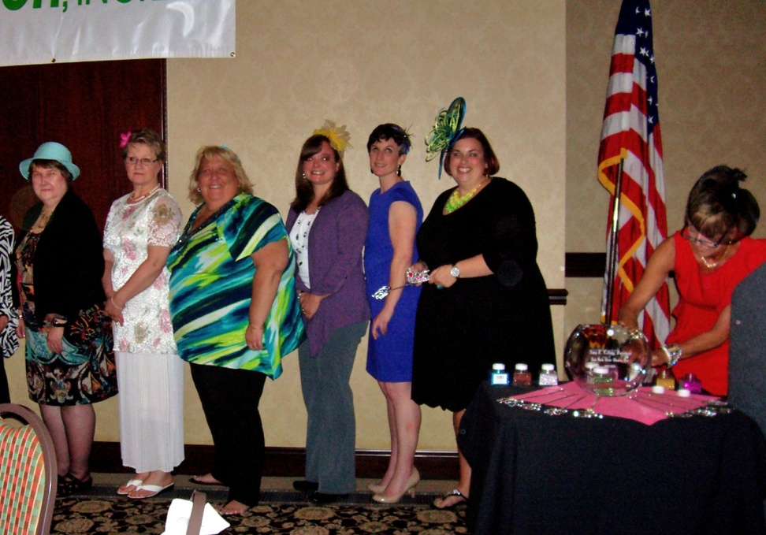
Creating an inviting environment
The Do’s
The do not’s

Slide 13
Thank you for coming
Katharine Smith
whiterabbitdesign@roadrunner.com
Neale Steiniger
nsteiniger@si.rr.com
Dana Rachlin
drachlin@courts.state.ny.us

